Slide 1
SparkPeople BioMetriX
Android app comparison

Slide 2
Comparing:
Messaging
Theme
Features
Retaining Users

Slide 3
Messaging (SparkPeople)
SparkPeople is a weight loss and fitness tracker/coach
Connects with SparkPeople community and companion website
Lose weight by eating right and exercising while using app to track goals

Slide 4
Messaging (BioMetriX)
Measure and track biometrics to improve:
Mental Health
Happiness
General Health

Slide 5
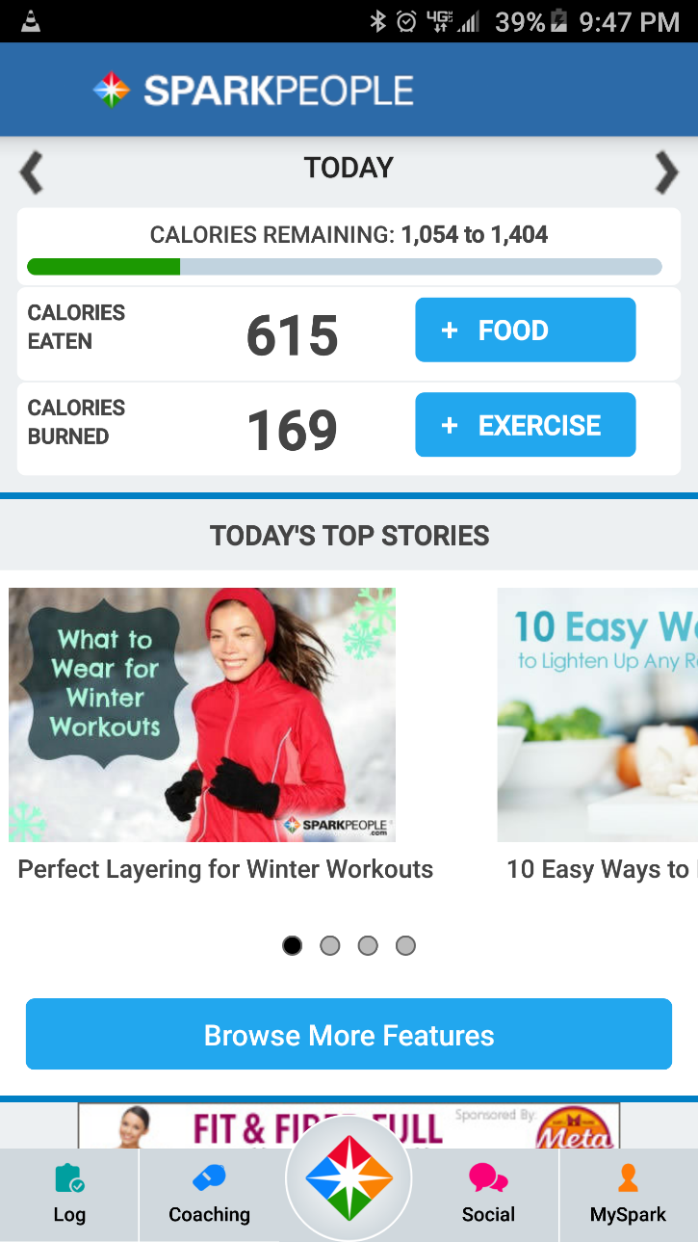
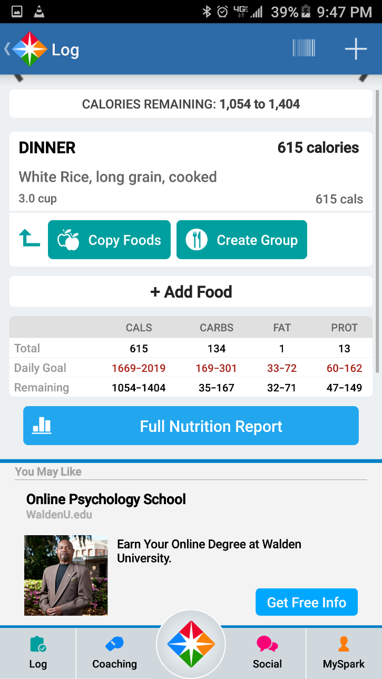
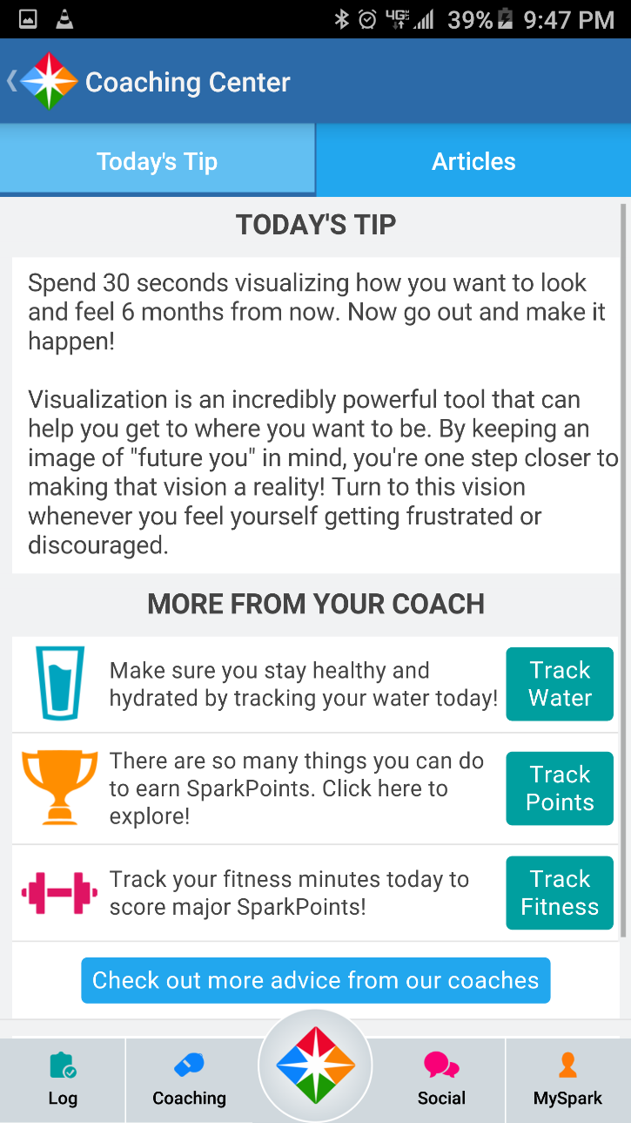
Theme (SparkPeople)

Slide 6
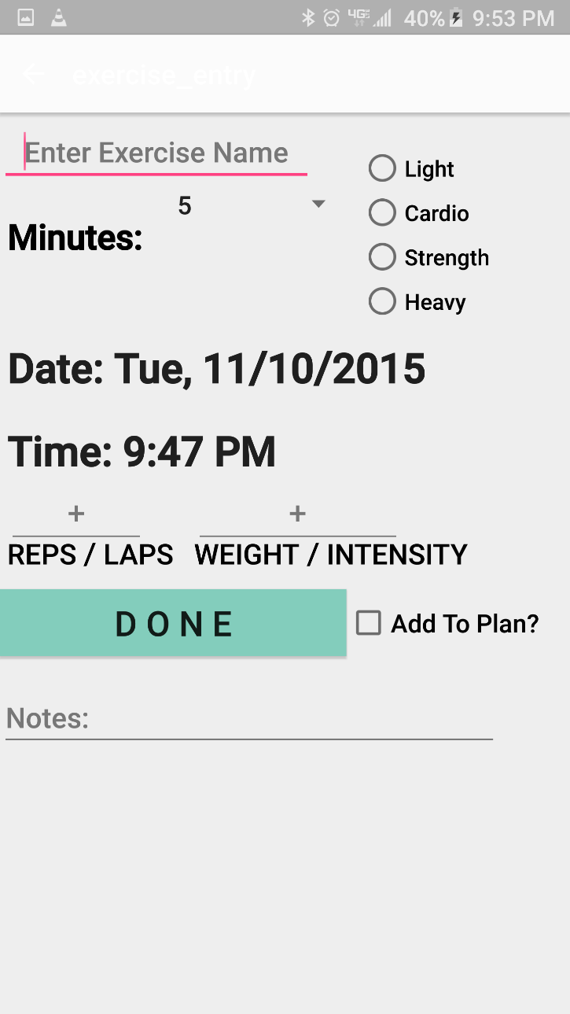
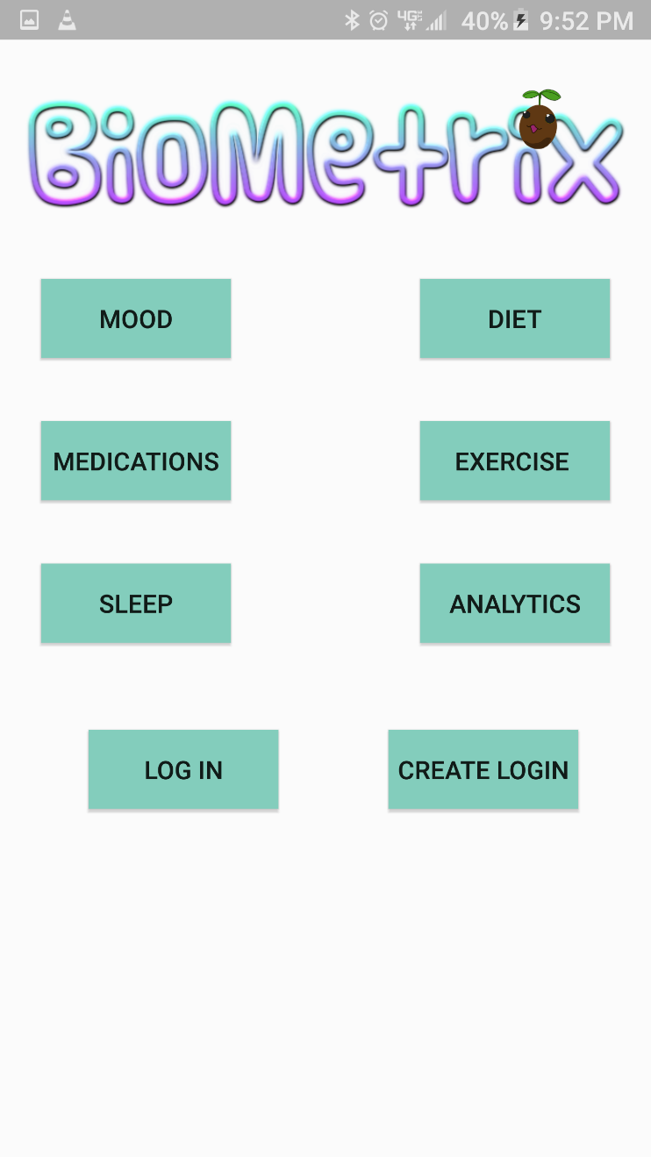
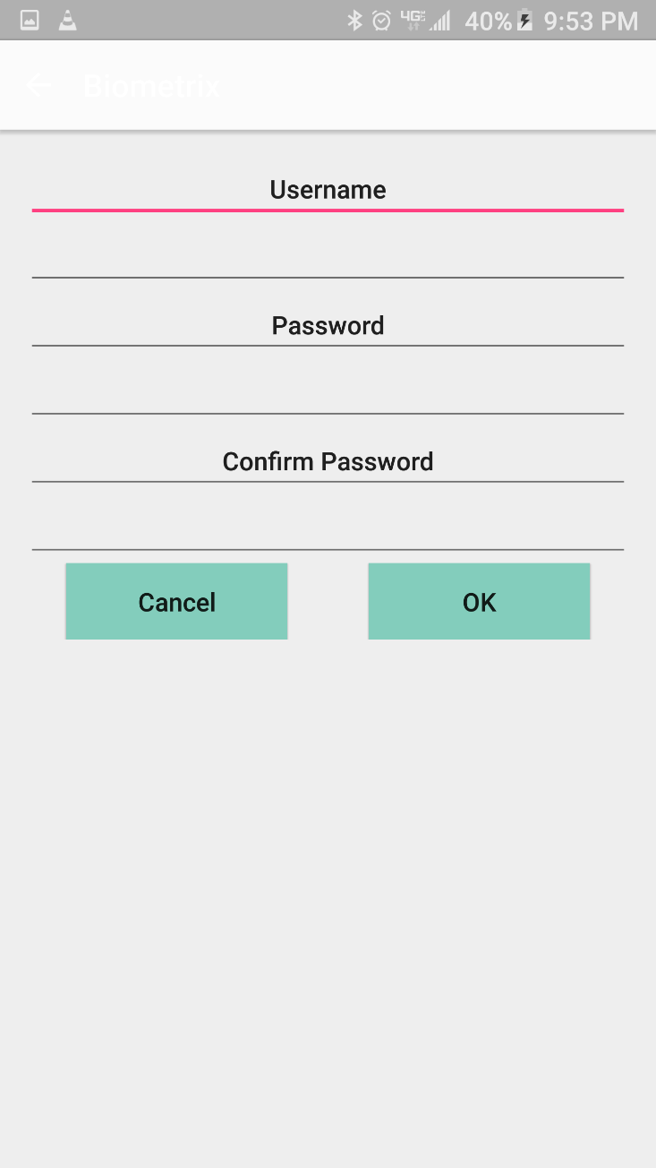
Theme (BioMetriX)

Slide 7
Features (SparkPeople)
Custom weight loss plan daily Calories
Meal entry w/ nutrition and Calorie info
Exercise plan
Exercise entry w/ Calorie info

Slide 8
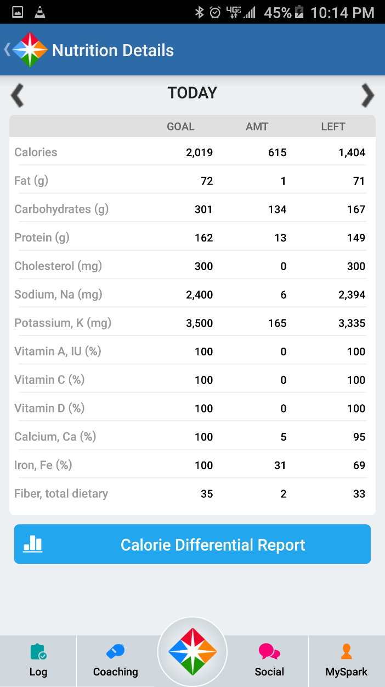
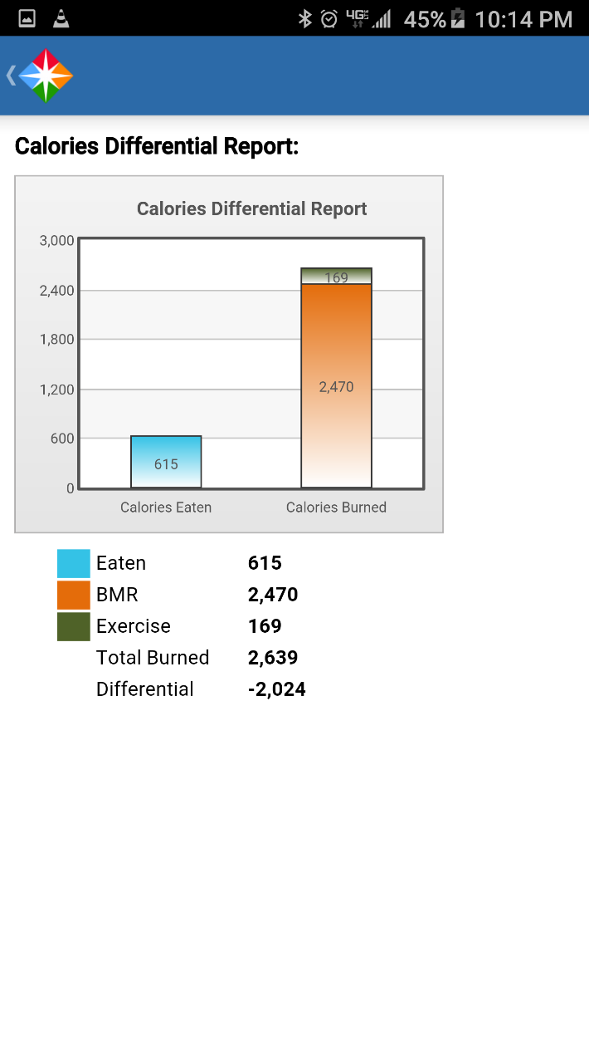
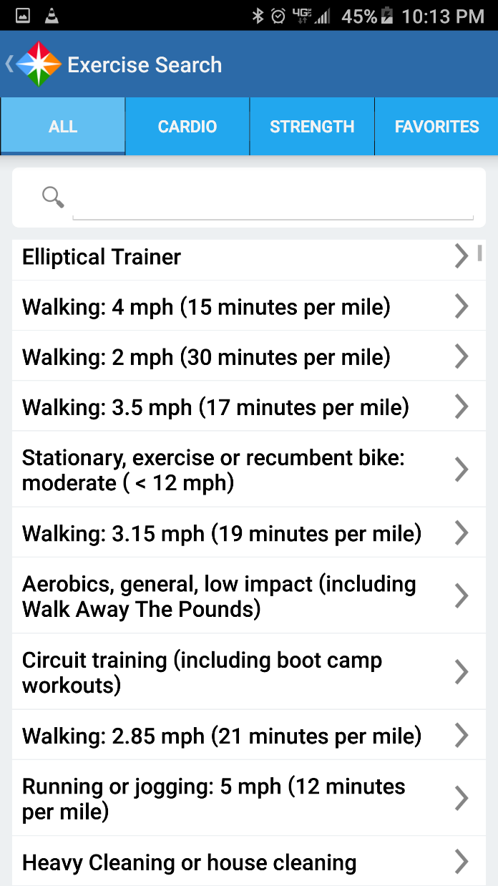
Features (SparkPeople)

Slide 9
Features (SparkPeople)
Article integration
Links to SparkPeople.com
Community blogs and challenges
Ads and monetization $$$

Slide 10
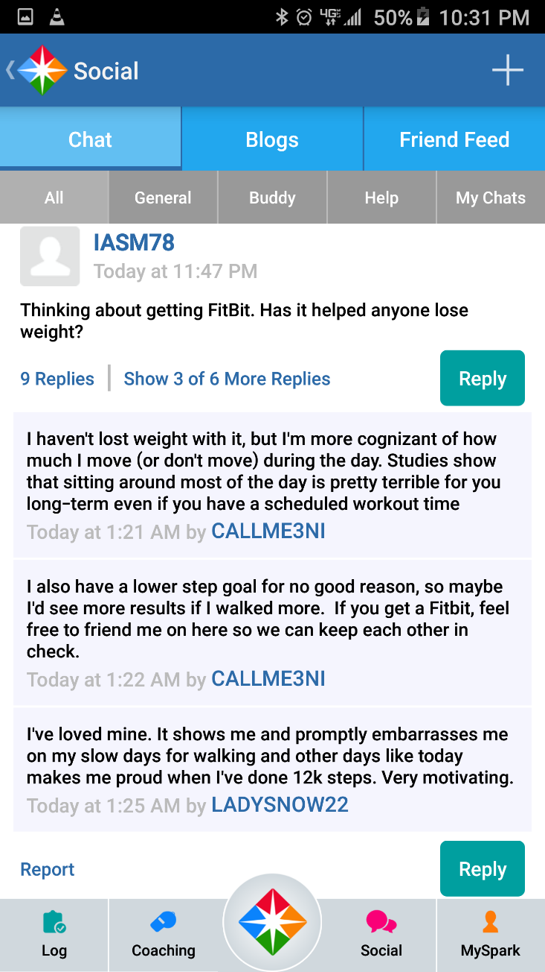
Features (SparkPeople)

Slide 11
Features (BioMetriX)
Customizable Modules
Biometric trends relative to a custom module
Free, No-Ads, Open Source

Slide 12
Retention (SparkPeople)
Social functions (friends, blogs, article comments)
Trends over time
Notifications

Slide 13



Retention (BioMetriX)
In-App Pets
In-App Reward Currency and ways to spend it.

